Slide 1
Predicting the NFL Game Winner
Group 1
Samuel aboma
Samuel Kuczynski
Felipe Serrano
vYtas stuopis

Slide 2
Agenda
Topic Discussion
Technologies Used
Questions we will be answering
Data Discussion
Model Discussion
Data Visualizations
Questions

Slide 3
Topic Discussion
Popularity of NFL
Fanbases
Global Game
Betting
Fantasy sports
Keys to the game
Strategy
Coaching
Team Strengths

Slide 4
Technologies Used
Open ML
Data Source
Quick DBD
ERD Diagram Creation
Python
Cleaning Data
AWS
Server
PGAdmin
SQL

Slide 5
Questions we will be answering
What 3 key metrics a team needs to meet to be the winners of an NFL Game
Point Scored Differential
Turnover Differential
Time of Possession

Slide 6
Data Discussion
NFL Game Statistics from ESPN from 2002 to 2022 season
Focus on the 3 statistics
Others included in the dataset

Slide 7
Data Exploration
Cleaning Data
Only Keeping needed columns
Conversions or none required?

Slide 8
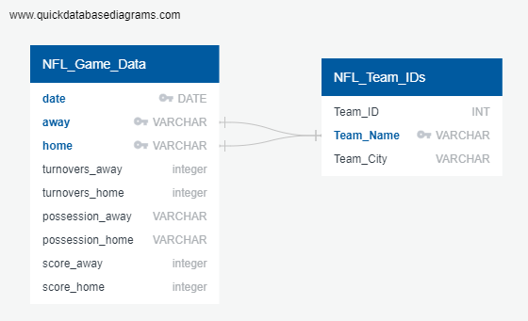
ERD DIAGRAM

Slide 9
Project Analysis Phase

Slide 10
Model Discussion

Slide 11
Was the model successful?

Slide 12
Other Models one could use?

Slide 13
Data Visualizations Used

Slide 14
Questions
?

